Slide 1
CS 540 Network Architecture
Lecture 9: TCP
Prof. Younghee Lee

Slide 2
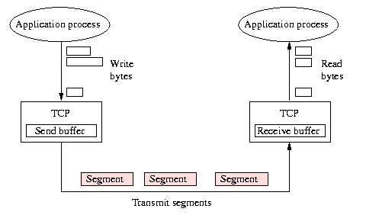
Transmission control protocol
Connection-oriented
Reliable, Ordered, Byte-stream
sending process writes some number of bytes (not packets)
TCP breaks into segments and sends via IP
Flow control: keep sender from overrunning receiver
Congestion control: keep sender from overrunning network
Fate sharing

Slide 3
Differences with Link Layers?
Variable RTT
May vary within a connection
What should the timeout be?
Reordering
Ensure sequences numbers are not reused
How long can packets live → max segment lifetime
MSL = 120 seconds based on IP behavior
Transmission rate
Don’t directly know transmission rate

Slide 4
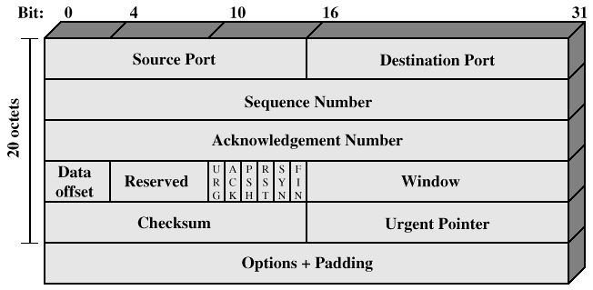
Transmission control protocol
TCP header

Slide 5
Transmission control protocol
Each connection identified with 4-tuple:
<SrcPort, SrcIPAddr, DstPort, DstIPAddr>
Acknowledgment, SequenceNum, AdvertisedWindow
Sender's maximum window = Min (advertisedWindow, cwnd)
Flags: SYN, FIN, RESET, PUSH, URG, ACK
Checksum: pseudo header + tcp header + data
Push: notification from the sender to the receiver to pass all the data that it has to the receiving process (upper layer)

Slide 6
TCP flow control
Sliding window with cumulative acks
Ack field contains last in-order packet received
Duplicate acks sent when out-of-order packet received
ACK with a message of the form (A=i, W=j) means
All octets through i-1are acknowledged: Sender can send from i
Permission is granted to send an window of j octets. i through i+j – 1: receiver’s advertised window
The receiver can increase throughput by
optimistically granting credit for space it does not have.(think RTT)
Long distance with high speed links?, short distance with low speed links?

Slide 7
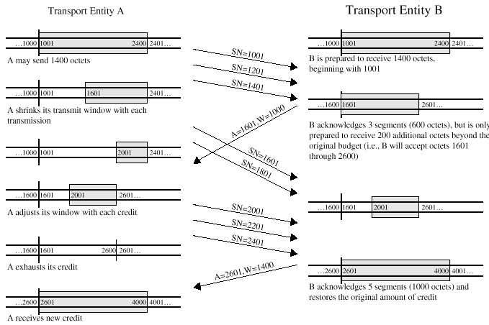
TCP flow control

Slide 8
Congestion Avoidance and Control
Van Jacobson
‘conservation of packets’
A new packet isn’t put into the network until an old packet leaves
The physics of flow predicts that systems with this property should be robust in the face of congestion.
three ways for packet conservation to fail
The connection doesn’t get to equilibrium
A sender injects a new packet before an old packet has exited
The equilibrium can’t be reached because of resource limits along the path.

Slide 9
Congestion Avoidance and Control: 1)
The connection doesn’t get to equilibrium?
Getting to equilibrium: Slow start
Since the receiver can generate acks no faster than data packets can get through the network, the protocol is ‘self clocking’ (next slide)
Congestion window: Slow start
When starting or restarting after a loss, set cwnd to one packet.
On each ack for new data, increase cwnd by one packet. (1,2,4…)
When sending, send the minimum of the receiver's advertised window and cwnd.
“Slow start” algorithm guarantees that a connection will source data at a rate at most twice the maximum possible on the path.
This prevents huge bursts when new connection setup

Slide 10
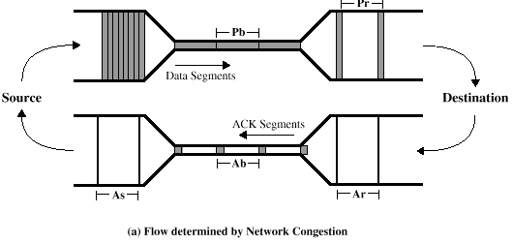
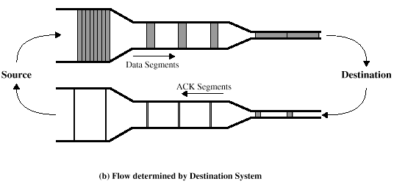
TCP congestion control
TCP Flow and Congestion Control
self-clocking behavior
The source has no way of knowing whether the pacing rate at which it receives ACKs reflects the status of the Internet (congestion control) or the status of the destination(flow control)
(Bottleneck Link Capacity) x Pb (or Pr or As) = (Size of a packet of packet Pair)

Slide 11
Congestion Avoidance and Control: 2)
A sender injects a new packet before an old packet has exited?
conservation at equilibrium: RTT
must represent a failure of sender’s retransmit timer
RTT estimation is essential core of timeout retransmits
RTT and variation in RTT: scale like (1/(1- ρ)) (ρ : network load)
network is running at 75% of capacity: round-trip-time to vary by a factor of sixteen ( -2σ to +2σ)
Setting the timeout to β * RTT estimate: β includes RTT variation
much better than using constant
eliminates wasted bandwidth when load gets high and delayed packets are retransmitted. (pouring gasoline on a fire)
exponential backoff (increase in retransmit timeout) : only one scheme has any hope of working

Slide 12
M/M/1 Queue (FYI)

Slide 13
Retransmission strategy: Timer driven
Error control/ Flow control of TCP: Timer driven
positive acknowledge only
Key design issue in TCP: the value of the retransmission timer
if too small -> unnecessary retransmissions
if too big -> sluggish in responding to a lost segment
should be longer than RTT
Why longer?: Delay will vary with changing Internet conditions
fixed timer ?; delay variance
Adaptive scheme ?; own problems to measure
Spurious timeouts
“Conservation of packets” principle* – more than a window worth of packets in flight
For a connection to be in equilibrium and for a packet flow to be conservative, a new packet isn't put into the network until an old packet leaves.
A sudden delay increase can cause a spurious TCP timeout: e.g. delay of wireless link due to cell changes
calculating the round-trip timing should take into account the round-trip variance
Timestamp? Random delay injection?...

Slide 14
Retransmission strategy
Simple moving average
Exponential moving average

Slide 15
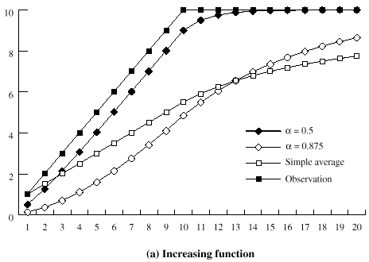
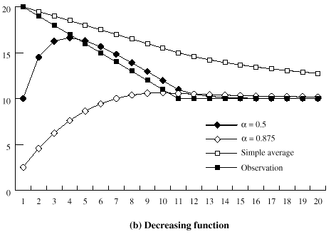
Retransmission strategy

Slide 16
Retransmission timer management; RTT variance estimation
RTT variance estimation(Jacobson’s Algorithm)
RTT: relatively high variance: At high loads, round trip variance is high
when data rate on the TCP connection is low -> transmission delay is relatively large compared to propagation delay -> variance in IP datagram size is significant -> property of data network
abrupt changes in RTT due to traffic from other source
due to cumulative acknowledgement
Mean absolute deviation
Simple moving average

Slide 17
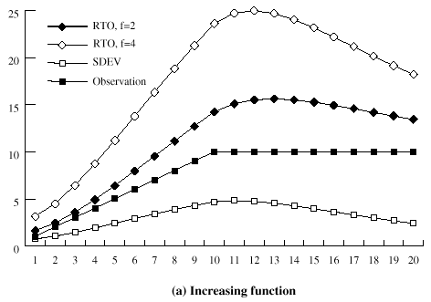
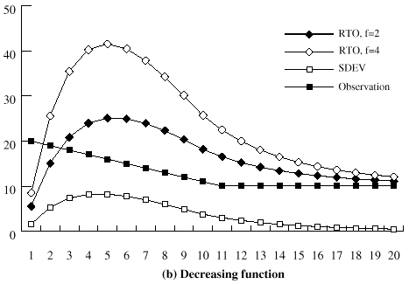
Retransmission timer management; RTT variance estimation
Exponential moving average

Slide 18
Retransmission timer management; Exponential RTO backoff
A more sensible policy
TCP source increase its RTO each time the same segment is retransmitted.
RTO=q X RTO: commonly used value of q is 2
Timestamp Extension
Used to improve timeout mechanism by more accurate measurement of RTT
When sending a packet, insert current timestamp into option
4 bytes for seconds, 4 bytes for microseconds
Receiver echoes timestamp in ACK
Actually will echo whatever is in timestamp
Removes retransmission ambiguity
Can get RTT sample on any packet

Slide 19
Congestion Avoidance and Control: 3)
The equilibrium can’t be reached because of resource limits along the path.
Adapting to the path: congestion avoidance : AIMD
timeout ➔ lost packet or congestion(queue backup ➔ packet drop)
Packet corruption extremely rare in wired link (no longer true in wireless link ➔ thus timeout implies congestion.
Congestion ➔ queues back up exponentially(queueing theory) ➔ windows should decrease exponentially: W_{i} = dW_{i-1} (d < 1)
If no congestion, window sizes need to increase ➔ Small, linear increase in window size (exponential increase will lead to oscillations):
W_{i} = W_{i-1} + u (u << W_{max} )
3 lines of code
On any timeout, set cwnd to half the current window size
On each ack for new data, increase cwnd by 1/cwnd
When sending, send the minimum of the receiver’s advertised window and cwnd

Slide 20
Congestion Avoidance and Control
Gateway side of congestion control
gateways/routers are where multiple TCP sessions converge, this is the only place to ensure fairness. Gateways could drop packets from overly active connections to enforce this fairness.
Van Jacopson did amazing job
Slow start for short lived flow?
Available bandwidth estimation

Slide 21
TCP Congestion Control
Idea
assumes best-effort network (FIFO or FQ routers)
ACKs pace transmission (self-clocking): segment and ACKs rate is equal to that of the slowest link on the path
How about sending rate control based upon ACKs rate?
Challenge
determining the available capacity in the first place
adjusting to changes in the available capacity

Slide 22
Approaches towards congestion control
Two broad approaches towards congestion control:
End-end congestion control:
no explicit feedback from network
congestion inferred from end-system observed loss, delay
approach taken by TCP
must trust end hosts to do right thing
Network-assisted congestion control:
routers provide feedback to end systems
single bit indicating congestion (SNA, DECbit, TCP/IP ECN, ATM)
explicit rate sender should send at
Congestion control by router:
Isolating well-behaved from ill-behaved sources

Slide 23
TCP Saw Tooth Behavior
Congestion
Window
Timeouts
may still
occur
Time
Initial
Slowstart
Slowstart
to pace
packets
Fast
Retransmit
and Recovery

Slide 24
Evolution of TCP
1975
Three-way handshake
Raymond Tomlinson
In SIGCOMM 75
1984
Nagel’s algorithm
to reduce overhead
of small packets;
predicts congestion collapse
1987
Karn’s algorithm
to better estimate round-trip time
1990
4.3BSD Reno
fast retransmit
delayed ACK’s
1983
BSD Unix 4.2
supports TCP/IP
1986
Congestion collapse
observed
1988
Van Jacobson’s algorithms
congestion avoidance and congestion control
(most implemented in 4.3BSD Tahoe)
1974
TCP described by
Vint Cerf and Bob Kahn
In IEEE Trans Comm
1982
TCP & IP
RFC 793 & 791
1975
1980
1985
1990

Slide 25
TCP Through the 1990s
1994
T/TCP
(Braden)
Transaction
TCP
1996
SACK TCP
(Floyd et al)
Selective Acknowledgement
1993
TCP Vegas
(Brakmo et al)
real congestion avoidance
1994
ECN
(Floyd)
Explicit
Congestion
Notification
1996
Hoe
Improving TCP startup
1996
FACK TCP
(Mathis et al)
extension to SACK
1993
1994
1996

Slide 26
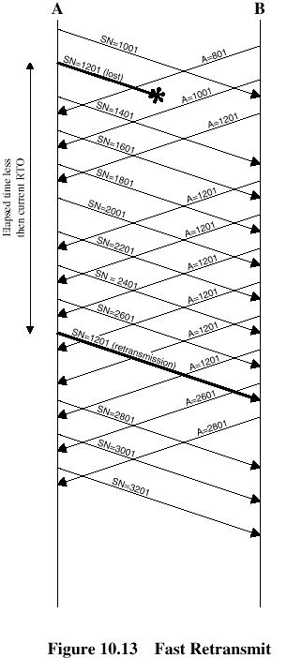
Fast Retransmit (Tahoe): for TCP reliability by Data driven
What are duplicate acks (dupacks)?
Repeated acks for the same sequence
When can duplicate acks occur?
Loss
Packet re-ordering: infrequent
Window update – advertisement of new flow control window
Assume re-ordering is infrequent and not of large magnitude
Use receipt of 3 or more duplicate acks as indication of loss
Don’t wait for timeout to retransmit packet

Slide 27
Fast Retransmit (Reno):
Congestion
Window
Timeouts
may still
occur
Initial
Slowstart
Slowstart
to pace
packets
Fast
Retransmit
and Recovery
Time
Fast recovery (Reno TCP)
Prevent the communication path from going empty after Fast Retransmission: avoiding the need to SS to refill
Assumes that each dup ACK received represents a single packet having left the pipe
ndup maintained at 0 until the # of dup ACKs reaches 3, and thereafter tracks the # of dup ACKs it has received
Sender retransmits one packet and reduces its congestion window by one half. It uses additional incoming dup ACKs to clock subsequent outgoing packet
Good for single packet loss, Timeout for multiple packet losses
With multiple losses, Reno typically timeouts because it does not see duplicate acknowledgements
< See simulation >

Slide 28
NewReno
The ack that arrives after retransmission (partial ack) should indicate that a second loss occurred
Immediate retransmission
When does NewReno timeout?
When there are fewer than three dupacks for first loss
When partial ack is lost
How fast does it recover losses?
One per RTT
< See simulation >

Slide 29
TCP SACK
Selective acknowledgement : Good for burst packet loss
Bitmask of packets received
The receiver can acknowledge non-continuous blocks of data (SACK 0-1023, 1024-2047)
Multiple blocks can be sent in a single segment
The receiver sends back ACKs to inform the sender that the data has been successfully received so that the sender can then retransmit only the missing packet
Basic problem of TCP-New Reno:
Ack for just the packet received
What if acks are lost? → carry cumulative also
retransmit at most 1 lost packet per round trip time
How to deal with reordering

Slide 30
TCP SACK
Triggering Segment | ACK | 1st Block Left Edge | 1st Block Right Edge | 2nd Block Left Edge | 2nd Block Right Edge | 3rd Block Left Edge | 3rd Block Right Edge
5000 | 5500
5500 | (lost)
6000 | 5500 | 6000 | 6500
6500 | (lost)
7000 | 5500 | 7000 | 7500 | 6000 | 6500
7500 | (lost)
8000 | 5500 | 8000 | 8500 | 7000 | 7500 | 6000 | 6500
8500 | (lost)
Good for burst packet loss(when multiple segment loss)

Slide 31
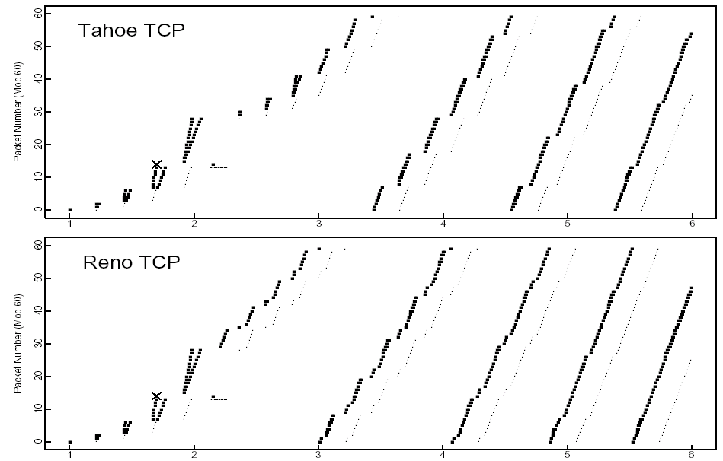
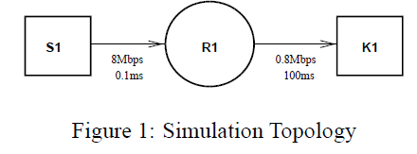
Simulation with one dropped packet
tracing packets entering and departing from R1
Queuing delay at R1
tracing packets entering and departing from R1

Slide 32
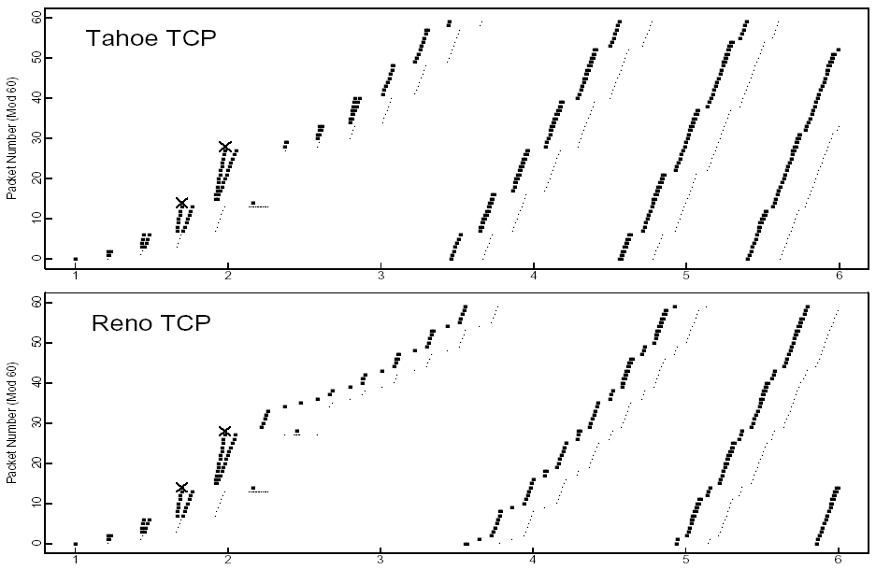
Simulation with two dropped packets

Slide 33
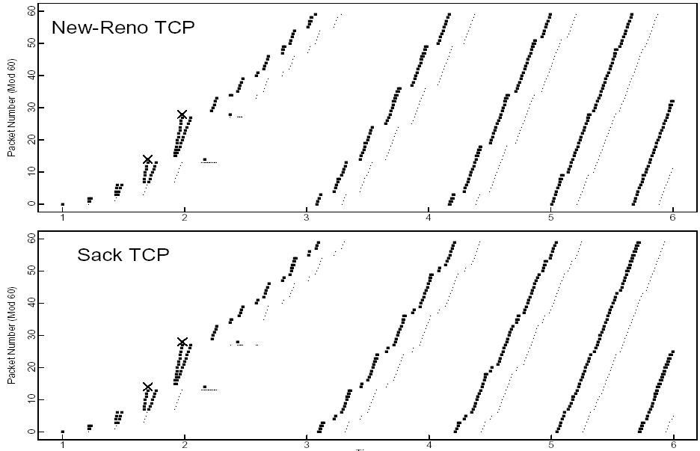
Simulation with two dropped packets

Slide 34
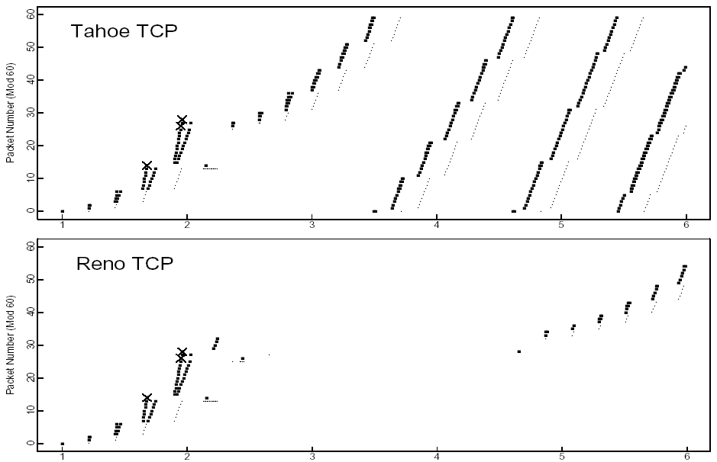
Simulation with three dropped packets
Partial ack

Slide 35
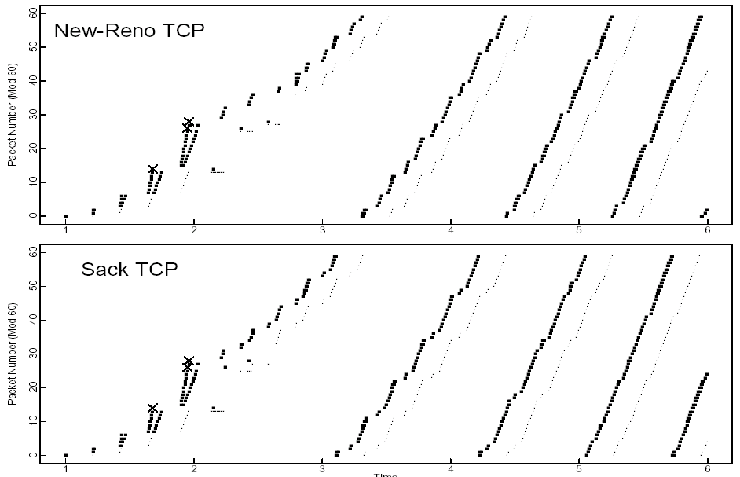
Simulation with three dropped packets
Partial ack

Slide 36
Observed TCP Problems
Timeout >> fast rexmit
Need 3 dupacks/sacks
Not great for small transfers
Don’t have 3 packets outstanding
Too many small packets
Solution: Delayed ACKS
Don’t ACK data immediately
Wait 200ms (must be less than 500ms – why?)
Must ACK every other packet(full sized incoming segment)
Must not delay duplicate ACKs(why?)
reducing protocol overhead but reducing application performance
Silly Window Syndrome

Slide 37
Silly Window Syndrome
Problem: (Clark, 1982)
If receiver advertises small increases in the receive window(due to small available buffer size) then the sender may waste time sending lots of small packets => receiver can’t process all incoming data => almost buffer full => vicious cycle)
Silly window syndrome occurs when the window is almost full.
Solution
Receive-side silly window avoidance:(David Clack)
Receiver must not advertise small window increases
Increase window by min(MSS, RecvBuffer/2)

Slide 38
Silly window syndrome: Nagel’s Algorithm
Small packet problem:
Don’t want to send a 41 byte packet for each keystroke
1 byte of information + 40 bytes header : telnet session
How long to wait for more data?
Applications such as networked multiplayer video games?
use TCP_NODELAY (set to on) to bypass the Nagle delay.
Solution: Send-side silly window avoidance
The sender sends the first segment even if it is a small one. Then
The sender waits until an ACK is received or a maximum sized segment (MSS) is accumulated
keep buffering its output until it has a full packet's worth of output

Slide 39
Protection From Wraparound
Sequence Time Wraparound time vs. Link speed
1.5Mbps: 6.4 hours
10Mbps: 57 minutes
45Mbps: 13 minutes
100Mbps: 6 minutes
622Mbps: 55 seconds → < MSL!(Maximum Segment Lifetime ) 255sec
1.2Gbps: 28 seconds
Use timestamp to distinguish sequence number wraparound

Slide 40
Large Windows
Delay-bandwidth product for 100ms delay
equivalent to the maximum amount of data on the network circuit at any given time: Long Fat Networks(LFN) such as High Speed LAN or satellite link
1.5Mbps: 18KB
10Mbps: 122KB > max 16bit window : max. 65,535 bytes
45Mbps: 549KB
100Mbps: 1.2MB
622Mbps: 7.4MB
1.2Gbps: 14.8MB
Scaling factor on advertised window
TCP window scale option
Specifies how many bits window must be shifted to the left
Scaling factor exchanged during connection setup

Slide 41
Maximum Segment Size (MSS)
Exchanged at connection setup
Typically pick Maximum Transmission Unit (MTU) of local link
What all does this effect?
Efficiency
Congestion control
Retransmission
Path MTU discovery
IP Datagram Size: Maximum Transmission Unit (MTU)
Why should MTU match MSS?

Slide 42
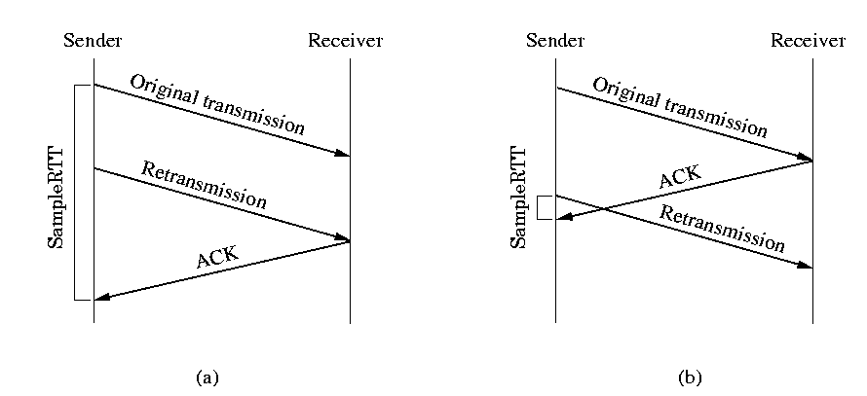
Retransmission timer management; Karn’s algorithm
Suppose that a segment times out and must be retransmitted.
An subsequent ACK can be the one to the first transmission of the segment
This can be ACK to the second transmission
TCP cannot distinguish
Karn’s algorithm.
Do not use the measured RTT for a retransmitted segment
Calculate the backoff RTO when a retransmission occurs
Use the backoff RTO until an ACK arrives without retransmission

Slide 43
Timer Granularity
Many TCP implementations set RTO in multiples of 200,500,1000ms
Why?
Avoid spurious timeouts – RTTs can vary quickly due to cross traffic
Make timers interrupts efficient

Slide 44
TCP Persist
TCP Persist state
If an acknowledgment is lost, we could end up with both sides waiting for the other
TCP persist timer
Sender periodically sends 1 byte packets
Why 1 byte?
Receiver responds with ACK even if it can’t store the packet

Slide 45
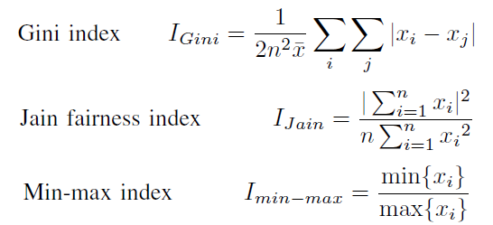
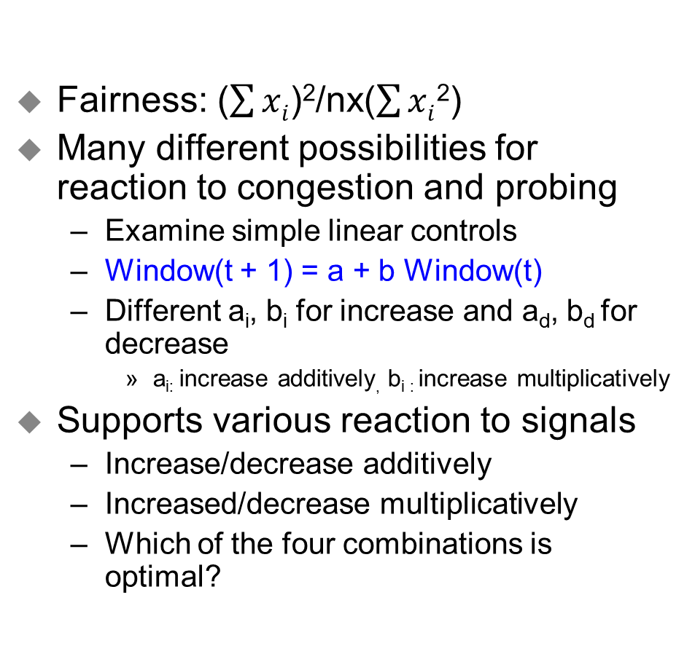
Fairness
Fairness: ($\sum{xi}$)²/nx($\sum{xi}$²)
Many different possibilities for reaction to congestion and probing
Examine simple linear controls
Window(t + 1) = a + b Window(t)
Different a_{i}, b_{i} for increase and a_{d}, b_{d} for decrease
a_{i:} increase additively, b_{i :} increase multiplicatively
Supports various reaction to signals
Increase/decrease additively
Increased/decrease multiplicatively
Which of the four combinations is optimal?

Slide 46
Phase plots
What are desirable properties?
X₂ = C –X₁
Fairness Line
C
Overload
User 2’s Allocation x₂
Optimal point
Underutilization
Efficiency Line
User 1’s Allocation x₁
C

Slide 47
Additive Increase/Decrease
Both X₁ and X₂ increase/decrease by the same amount over time
Additive increase improves fairness and additive decrease reduces fairness
Fairness Line
T₁
User 2’s Allocation x₂
T₀
Efficiency Line
User 1’s Allocation x₁

Slide 48
Multiplicative Increase/Decrease
Both X₁ and X₂ increase by the same factor over time
Extension from origin – constant fairness
Fairness Line
T₁
User 2’s Allocation x₂
T₀
Efficiency Line
User 1’s Allocation x₁

Slide 49
Constraints
Distributed efficiency
I.e.,  Window(t+1) >  Window(t) during increase
a_{i} > 0 & b_{i} ≥ 1
Similarly, a_{d} < 0 & b_{d} ≤ 1
Must never decrease fairness
a & b’s must be ≥ 0
a_{i}/b_{i} > 0 and a_{d}/b_{d} ≥ 0
Full constraints
a_{d} = 0, 0 ≤ b_{d} < 1, a_{i} > 0 and b_{i} ≥ 1

Slide 50
What is the Right Choice?
Constraints limit us to AIMD
Can have multiplicative term in increase (MAIMD)
AIMD moves towards optimal point
x₁
Fairness Line
x₀
User 2’s Allocation x₂
x₂
Efficiency Line
User 1’s Allocation x₁

Slide 51
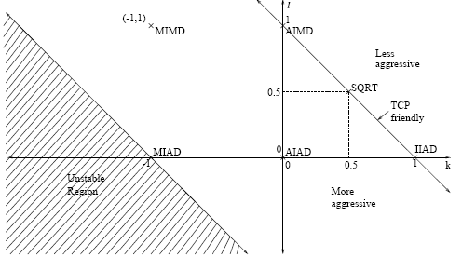
Binomial Congestion Control[Bansal01]
In AIMD
Increase: W_{n+1} = W_{n} + 
Decrease: W_{n+1} = (1- ) W_{n}
In Binomial: non linear congestion control
Increase: W_{n+1} = W_{n} + /W_{n}^{k}
Decrease: W_{n+1} = W_{n} -  W_{n}^{l}
k=0 & l=1 → AIMD,
k=-1 & l=1 → MIMD,
k=-1 & l=0 → MIAD,
k=0 & l=0 → AIAD
=> covering the class of all linear algorithm
l < 1 results in less than multiplicative decrease
Good for multimedia applications
k=1 & l=0 → IIAD (Inverse-Increase/Additive-Decrease), for TCP-friendly Congestion Control for Real-time Streaming Applications
k & l= 0.5 → SQRT,

Slide 52
Binomial Congestion Control
Rate ~ 1/ (loss rate)^{1/(k+l+1)}
If k+l=1 → rate ~ 1/p^{0.5} (Why? See next “Simple Loss Model)
TCP friendly if k+l ≤ 1
AIMD (k=0, l=1) is the most aggressive of this class
Good for applications that want to probe quickly and can use any available bandwidth

Slide 53
TCP Connection Management
Recall: TCP sender, receiver establish “connection” before exchanging data segments
initialize TCP variables:
seq. #s
buffers, flow control info (e.g. RcvWindow)
client: connection initiator
Socket clientSocket = new Socket("hostname","port number");
server: contacted by client
Socket connectionSocket = welcomeSocket.accept();
Three way handshake:
Step 1: client end system sends TCP SYN control segment to server
specifies initial seq #
Step 2: server end system receives SYN, replies with SYNACK control segment
ACKs received SYN
allocates buffers
specifies server-> receiver initial seq. #
Step 3: client receives SYNACK, replies with ACK segment, which may contain data

Slide 54
TCP Performance Issues
Consistently full queues can degrade TCP performance.
Lock out of some sessions
Synchronization of TCP sessions due to the dropping of bursts of packets
Penalizing of bursty flows
Increased queueing delay
Not all users sharing a bottleneck link get the same bandwidth.
Can be considered to be unfair
Malicious users can grab more bandwidth by modifying TCP or by using UDP.
Again a fairness issue - very hard problem

Slide 55
TCP Modeling
Given the congestion behavior of TCP can we predict what type of performance we should get?
What are the important factors
Loss rate
Affects how often window is reduced
RTT
Affects increase rate and relates BW to window
RTO
Affects performance during loss recovery
MSS
Affects increase rate

Slide 56
Transmission Rate
What is area under curve?
W = pkts/RTT, T = RTTs
A = avg window * time = ¾ W * T
What was bandwidth?
BW = A / T = ¾ W
In packets per RTT
Need to convert to bytes per second
BW = ¾ W * MSS / RTT
What is W?
Depends on loss rate
Packets transferred
Assumption: no timeouts and perfect loss recovery
W
W/2
Time

Slide 57
Simple Loss Model
What was the loss rate?
Packets transferred between the packet loss
(¾ W/RTT) * (W/2 * RTT) = 3W²/8
¾ W/RTT: number of packets per sec
W/2 * RTT: time between the packet loss
1 packet lost → loss rate : p = 8/3W²
BW = ¾ * W * MSS / RTT
Additional assumptions
Fixed RTT
No delayed ACKs
Each RTT window increases by 1 packet
→W/2 * RTT before next loss
W
¾ W
W/2
W/2
Time

Slide 58
Reading Assignment
Lisong Xu et al., “Binary Increase Congestion Control (BIC) for Fast Long-Distance Networks”
Sally Floyd et al., “Equation-Based Congestion Control for Unicast
Applications”
Submit less than 1 page report online via KLMS by 6pm Oct. 10 which is the day before the lecture of Oct. 12 (Tue.)
Submit also hard copy report at the beginning of the lecture of Oct. 12 (Tue.) as attendance check and for discussion

Slide 59
Discussion: picked up randomly
But, In current network has become a more complicated system. Congestion window has to be adjusted by flow type. There are two types of flow, First is short flow, such as Http traffic that is sensitive to latency. And the other one is long flow, That is throughput sensitive. This paper only deal with throughput based congestion control. But nowadays latency sensitive flow become more important for user experience.
However, packet conservation was not valid in the network because new packets are put into the network even if old packets do not leave yet. The network connection may not maintain the equilibrium. The sender may not consider that the ACK is still traveling in the network. The network resources may often reach upper bound of its limitation. I wonder why the designers of the internet had such “packet conservations” assumption at that time. Even though the connections between the sender and the receiver maintain 1:1, the traveling time of packets can be exceeded for some reasons. As the end to-end properties, the sender can push packets into the network at any time.

Slide 60
Discussion: picked up randomly
First of all, I am curious about the simulations. The simulation cannot deal with all kinds of real world situations. Also, the period of that time (93’) may not be correspond with other ages. Finally, the implementation of TCP may affect the performance seriously. Even if the SACK TCP is better than the others by the simulation, the solution in the real world might be different.
The inconvenience with this algorithm is that with weak transfers (such less than 10-100 packets), the implementation can be very slow, since the throughput is weak given that the window is small.
The paper also introduces a new algorithm, SACK TCP, that is based on Reno - the benchmarks on the paper show us that the performance of SACK and New-Reno are equivalent, but SACK needs to be implemented in both user ends - which makes it less deployable than New Reno. SACK has, however, a slight advantage when the number of packet losses grow. New-Reno seems an efficient algorithm, but it would be wise to implement SACK on all new devices.

Slide 61
Discussion: picked up randomly
Perhaps d should be very close to 0 in order to abort congestion as early as possible. I think the value used of d is 0.5. However, in scenarios with many peers connected to one congested router, we would obtain better results with a more aggressive approach. In other words, reducing the windows’ size more rapidly.
In real environment, there is no need to emphasize that even very small issue can bring system defects. However, how can we detect the small defect of a new research when the researchers have the urge to hide it? In other words, is there any measure to judge whether the added codes are big enough to hinge the system performance? In many papers that we've read, including this paper that shed clearer lights on the issue, adding elaborated control always fix the previous problem of the primitive, blunt system. However, how can we compare the cost of the elaboration and the cost of the bluntness? Is there standard, or recommended testing method? Or does it depend only on the judgment call of ISPs?

